Slide 1



Name of Project:
Bio-Fertilizer Recommendation System for Sustainable Agriculture

Slide 2

Learning Objectives:
Learn to use machine learning to recommend suitable bio-fertilizers for different crops.
Understand sustainable agriculture and the role of bio-fertilizers in reducing chemical use.
Gain skills in data preprocessing, feature engineering, and model evaluation.
Apply AI solutions to real-world agricultural problems.
GOAL
Source :
www.freepik.com/

Slide 3
Tools and Technology used:
Python – for data analysis, machine learning model development, and backend programming.
Pandas & NumPy – for data handling and numerical computations.
Scikit-learn – for machine learning algorithms, preprocessing, and model evaluation.
Imbalanced-learn (SMOTE) – to balance the dataset for better predictions.
Matplotlib & Seaborn – for data visualization and plotting confusion matrices.
Flask – for creating the web backend and connecting the model with a user interface
HTML, CSS, JavaScript – for frontend development and building a user-friendly web interface.
Pickle – to save and load trained models and scalers.
VS Code – for coding, testing, and debugging the project.

Slide 4
Methodology:
Data Collection & Preparation:
Collected crop and fertilizer datasets.
Cleaned the data and handled missing values.
Mapped crops to appropriate bio-fertilizers (Compost, Vermicompost, Rhizobium, etc.).
Feature Engineering:
Created new features like N_to_P, N_to_K, and P_to_K ratios from soil nutrient values to help the model learn better.
Data Preprocessing:
Scaled numerical features using StandardScaler.
Encoded categorical labels using LabelEncoder.
Applied SMOTE to balance the dataset and avoid bias toward certain crops.
Model Training:
Split the data into training and testing sets.
Used Random Forest Classifier with GridSearchCV to select the best hyperparameters.
Evaluated the model using accuracy, classification report, and confusion matrix.

Slide 5
Methodology:
Prediction Module:
Created a function that takes soil and environmental parameters as input.
Predicts the most suitable crop and its corresponding bio-fertilizer with recommended dosage.
Web Application:
Used Flask to build a simple web interface.
Users can input soil nutrients, crop type, and environmental conditions to get fertilizer recommendations in real time.
Visualization & Reporting:
Displayed confusion matrix and model performance metrics for better understanding.
User Interface
Flask Web App
Preprocessing
ML Model (RF)
Output to User
Bio-Fertilizer

Slide 6
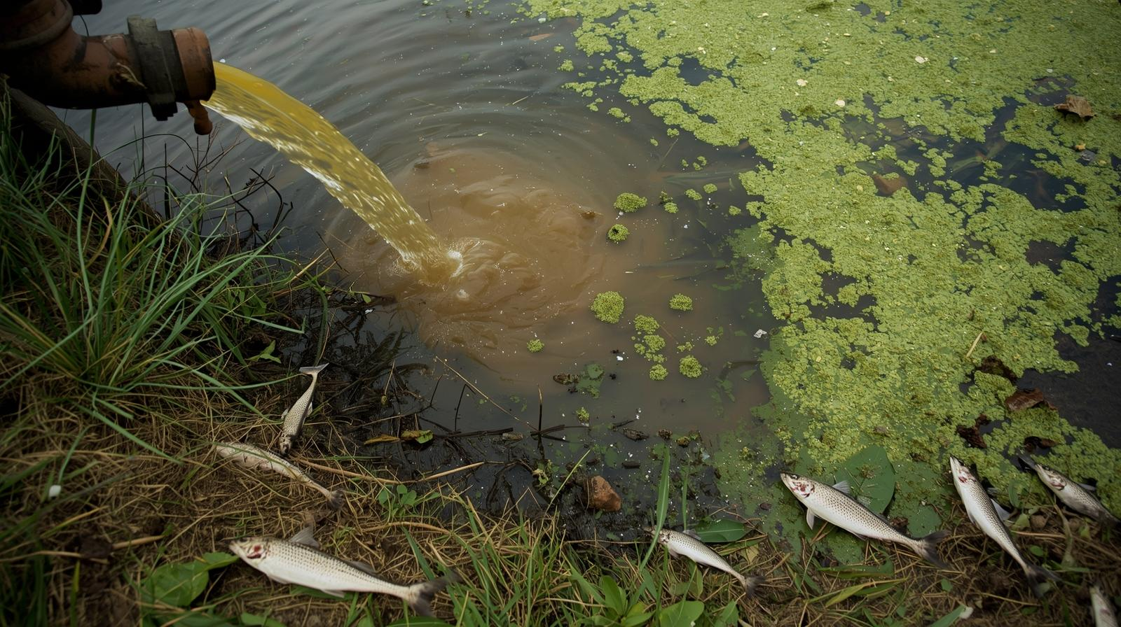
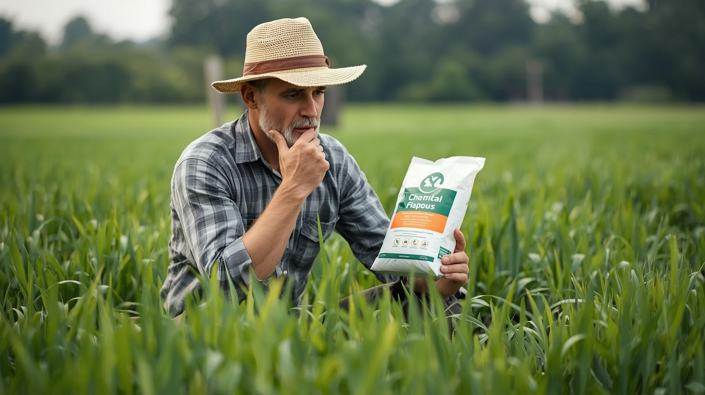

Problem Statement:
Farmers often overuse chemical fertilizers due to lack of guidance.
Overuse of chemicals increases farming costs and harms soil health.
Bio-fertilizers (compost, manure, vermicompost, Rhizobium) are sustainable alternatives.
There is no simple method for recommending the right bio-fertilizer for specific crops and soil.
Fertilizer runoff contaminates water and harms the environment.
Farmers lack easy access to eco-friendly and sustainable farming practices.

Slide 7
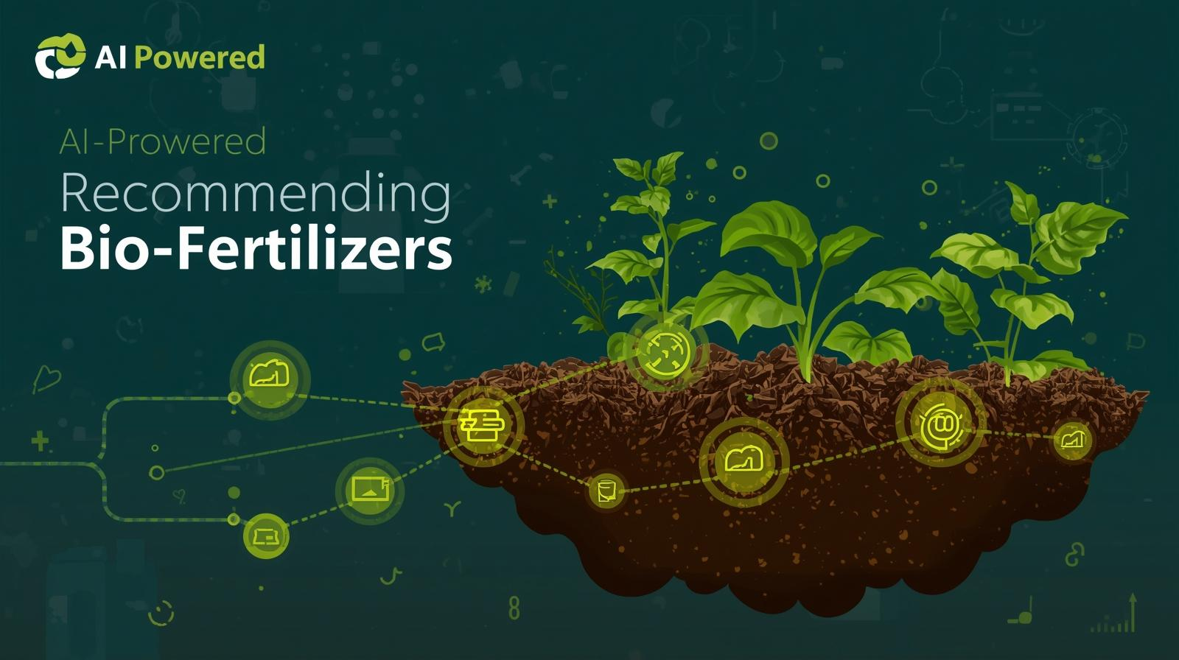
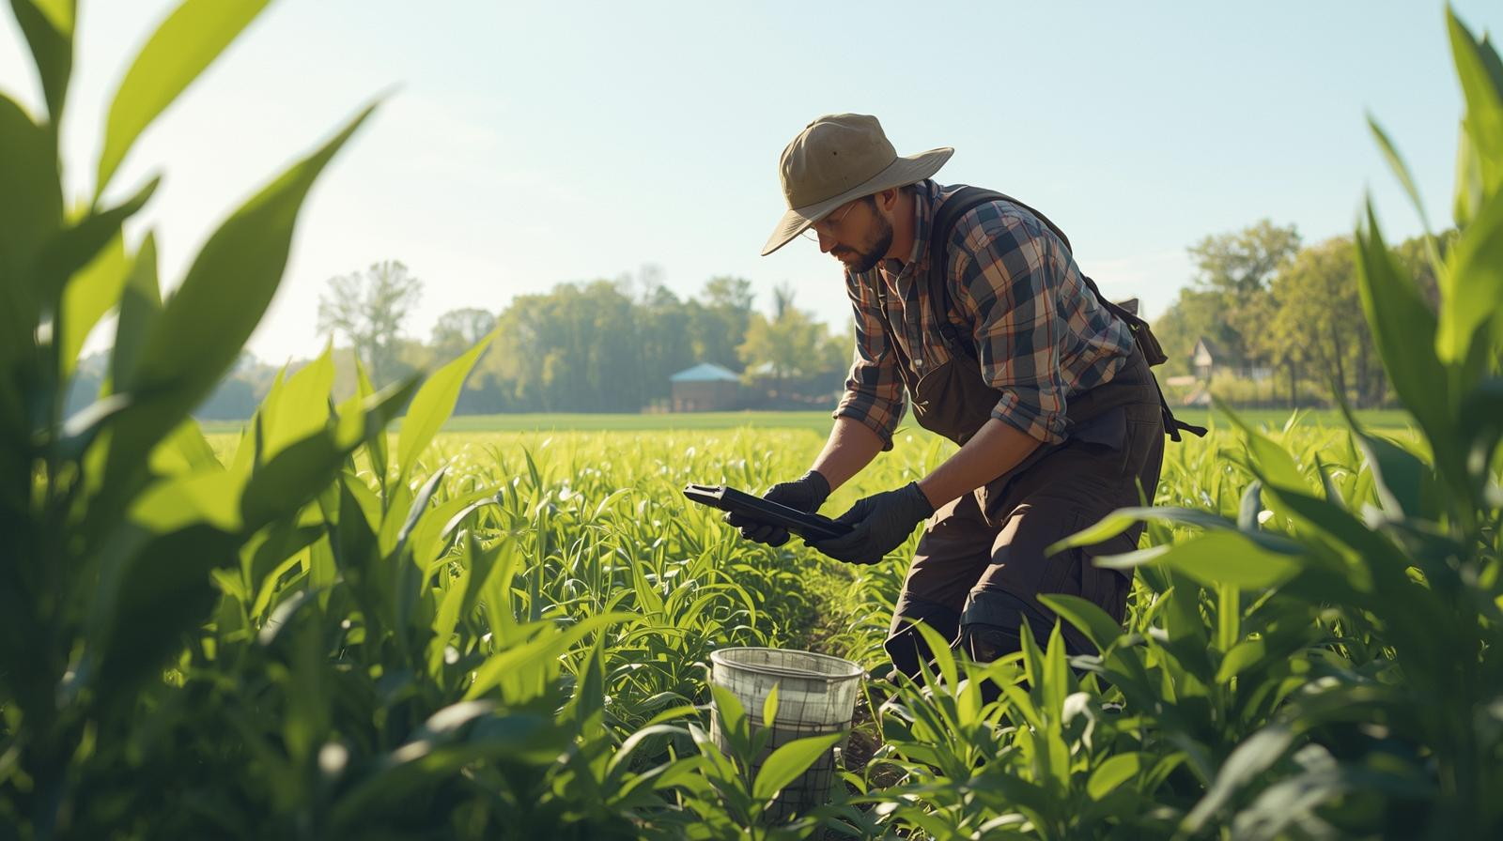
Solution:
The project aims to build an AI-powered system to recommend suitable bio-fertilizers.
Take soil nutrient values (N, P, K, pH), crop type, and environmental factors as input.
Use machine learning algorithms (like Random Forest) to predict crop requirements and bio-fertilizer recommendations.
Provide correct dosage and type of bio-fertilizer to farmers.
Reduce dependency on chemical fertilizers, improve soil fertility, and promote sustainable farming.
Helps farmers reduce chemical use, save money, and practice eco-friendly agriculture.

Slide 8
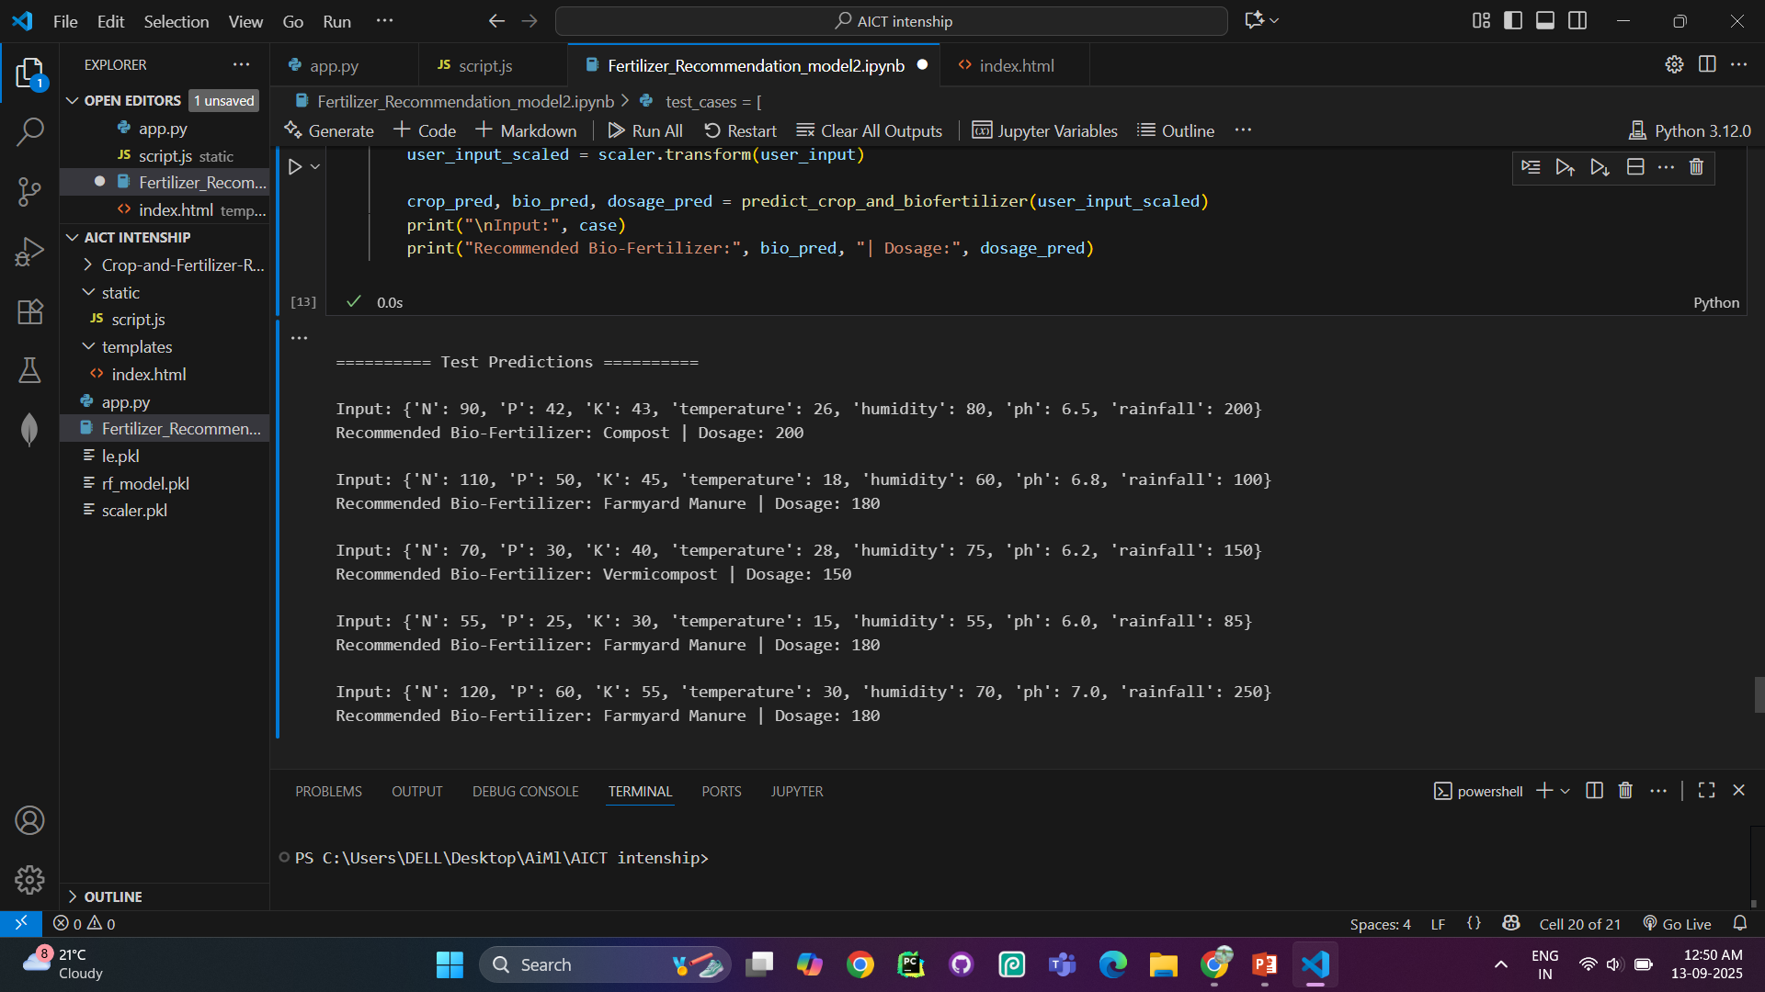
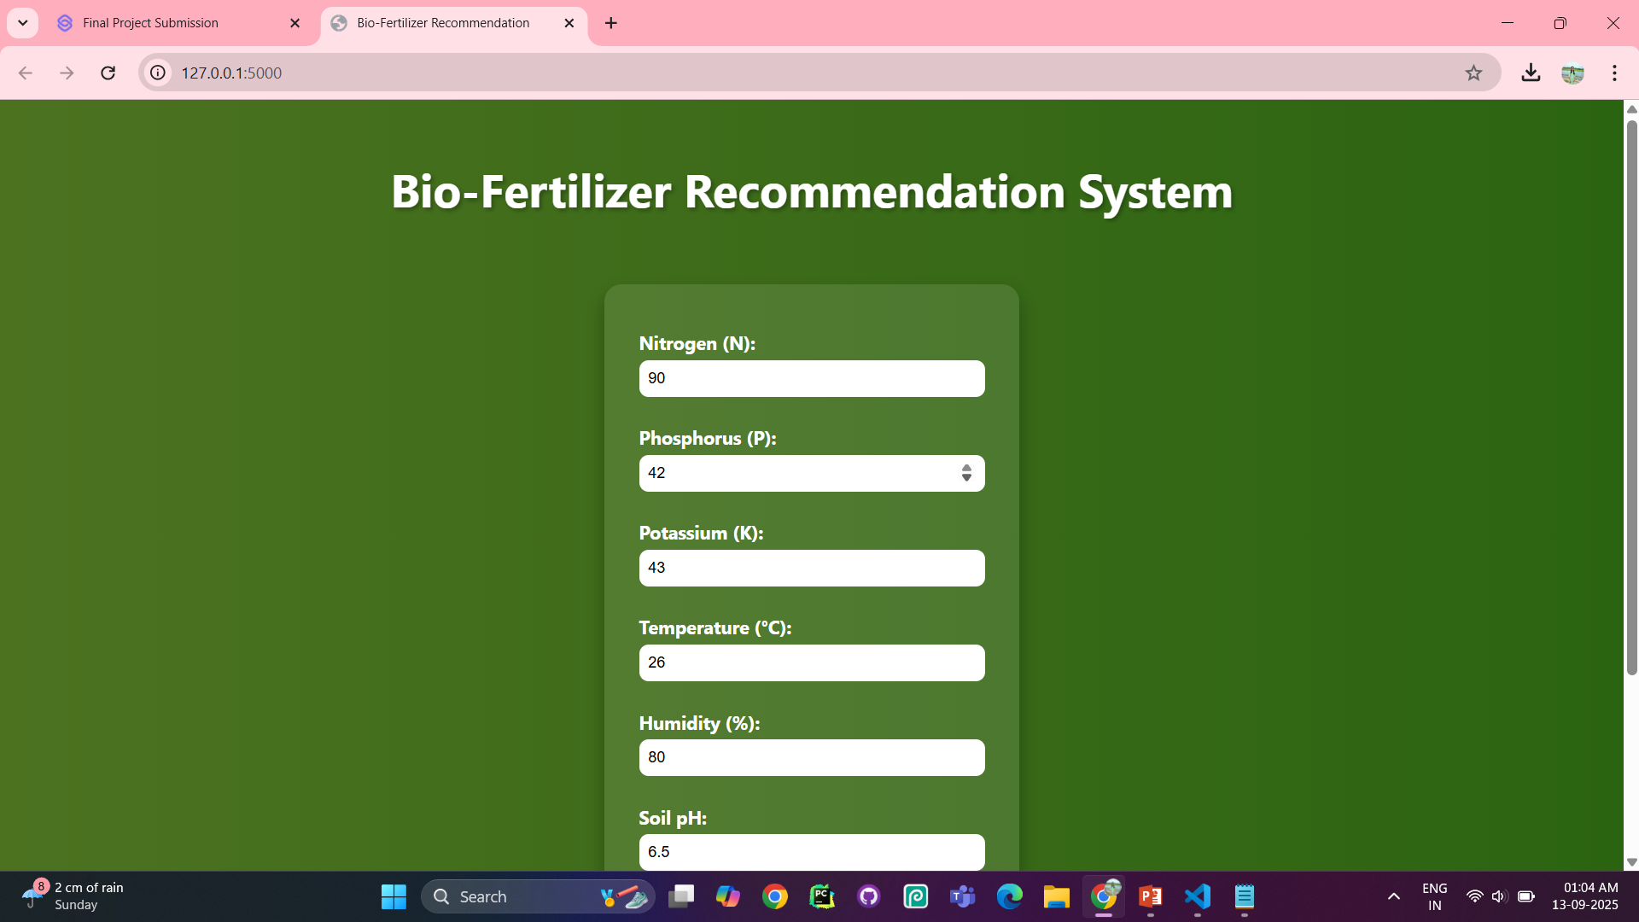
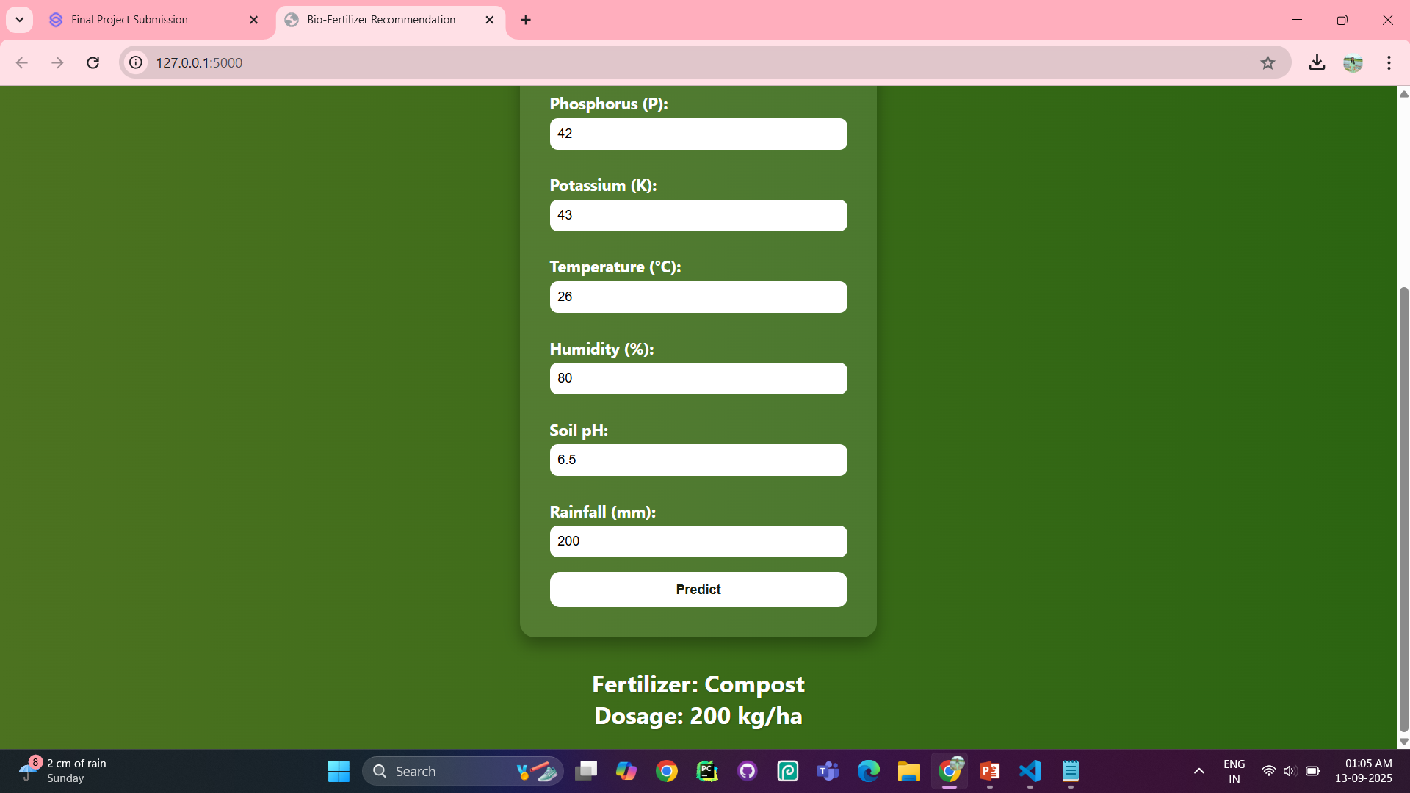
Screenshot of Output:

Slide 9
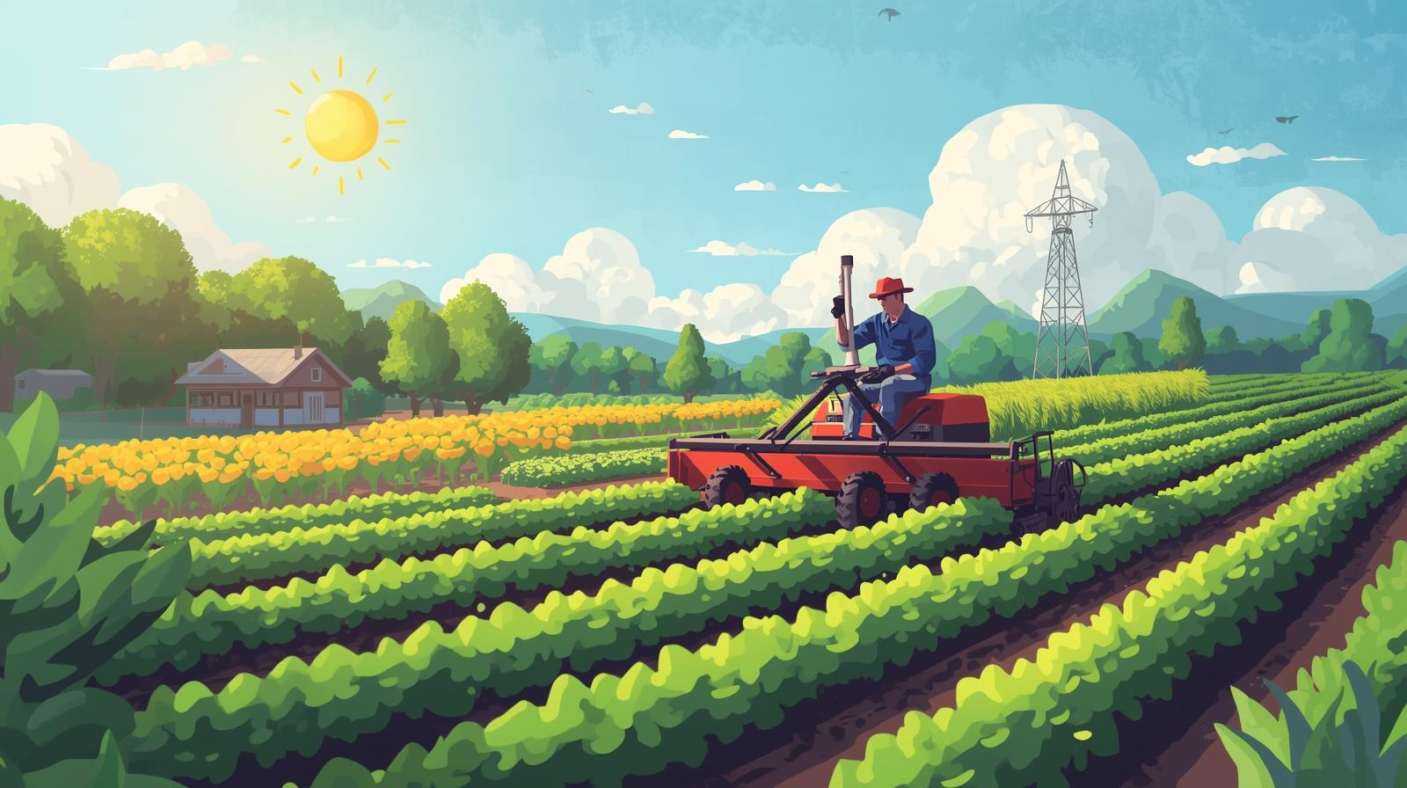
Conclusion:
The Bio-Fertilizer Recommendation System successfully demonstrates how artificial intelligence can be applied to promote sustainable agriculture. By analyzing soil nutrients (N, P, K, pH), weather conditions, and crop type, the system recommends the most suitable bio-fertilizer such as compost, vermicompost, or farmyard manure.The use of machine learning (Random Forest) ensures accurate predictions, while the Flask-based web interface allows farmers to easily input data and receive instant recommendations. This project helps reduce chemical fertilizer usage, improves soil health, lowers farming costs, and encourages eco-friendly farming practices. Overall, it provides a practical, accessible, and technology-driven solution to support sustainable agriculture.

